Slide 1




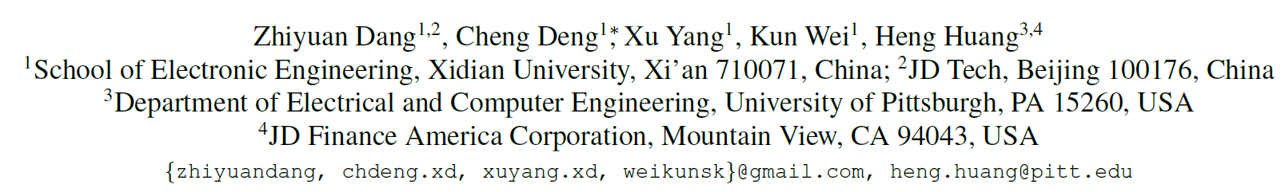
Nearest Neighbor Matching for Deep Clustering

Slide 2

Classical Clustering
aims to group the samples into clusters, such that similar samples into the same cluster while dissimilar ones into different clusters.
https://i.stack.imgur.com/cIDB3.png

Slide 3

Deep Clustering
(Clustering on CNN features) non-linearly transform the original samples into a latent embedded space for providing more promising performance.
K. Simonyan and A. Zisserman, Very deep convolutional networks for large-scale image recognition, In ICLR 2015.

Slide 4
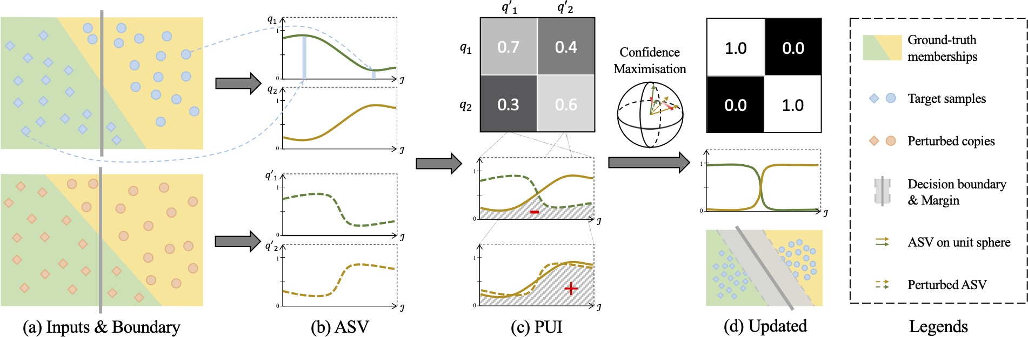
Deep Clustering Methods
PICA provides a recent strong baseline in deep clustering field.
J. Huang, S. Gong, and X. Zhu. Deep semantic clustering by partition confidence maximisation. In CVPR 2020.

Slide 5
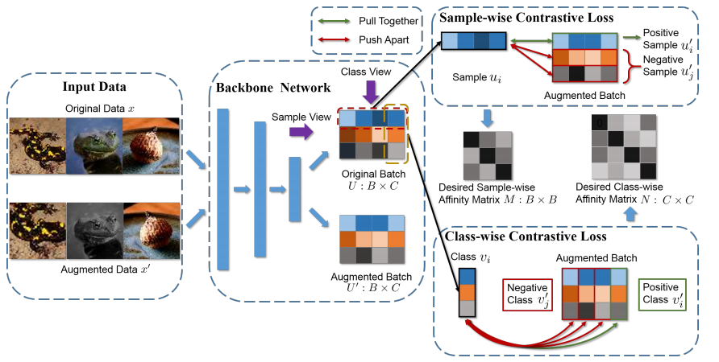
Deep Clustering Methods
DCDC provides a recent strong baseline in deep clustering field.
Z. Dang, C. Deng, X. Yang, and H. Huang. Doubly contrastive deep clustering. In ArXiv 2021

Slide 6
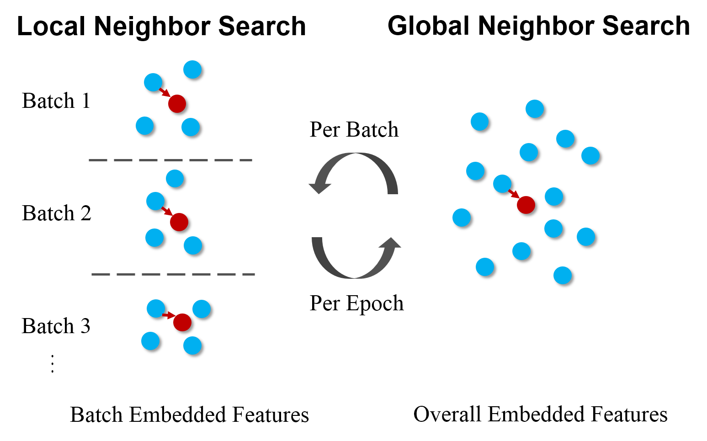
Motivation
Current approaches hardly take into consideration the semantic sample relationships that existed in both local and global features.
Two novel losses are proposed to improve the performance of Deep Clustering.

Slide 7
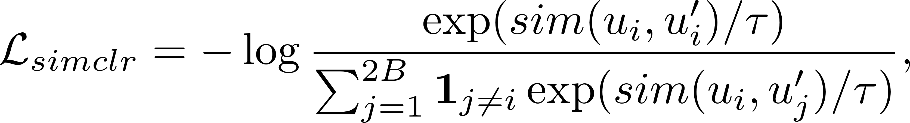
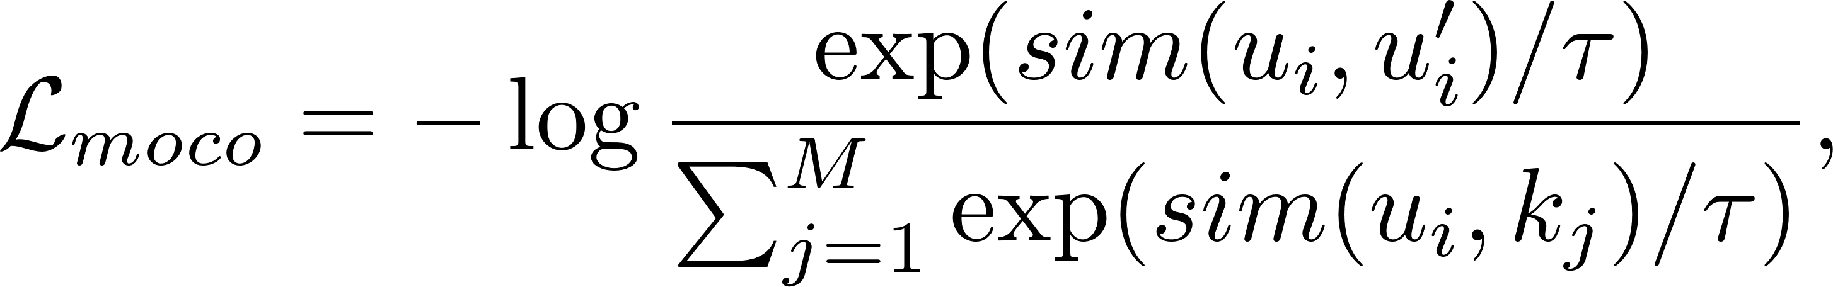
Nearest Neighbor Matching
Since the previous end-to-end deep clustering methods are sensitive to the network initialization, we consider to pre-train an unsupervised learning model (such as SimCLR and MoCo.)
T. Chen, S. Kornblith, M. Norouzi, and G. Hinton. A simple framework for contrastive learning of visual representations. In ICML 2020.
K. He, H. Fan, Y. Wu, S. Xie, and R. Girshick. Momentum contrast for unsupervised visual representation learning. In CVPR 2020.

Slide 8
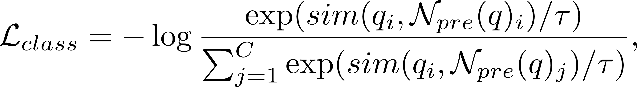
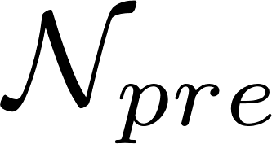
Nearest Neighbor Matching
With such pre-trained semantic features, our mined nearest neighbor will be meaningful. Two losses are proposed as follows :
consistent loss (maximize the similarity between samples and their neighbors)
class contrastive loss (to do contrastive learning in class view with neighbors):
is the mined nearest neighbors from the pre-trained model.

Slide 9
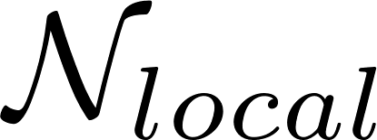
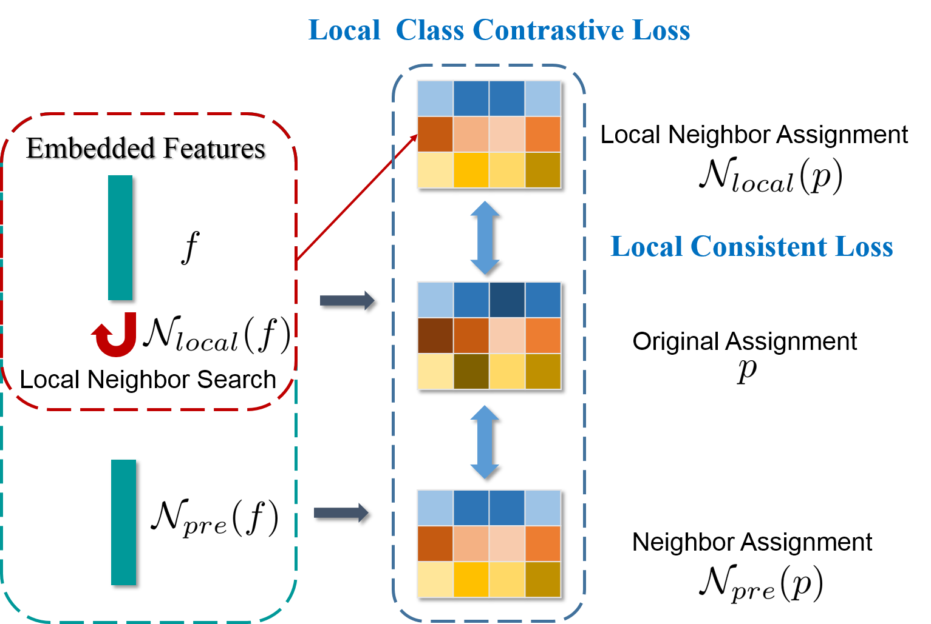
Local Nearest Neighbor Matching
Besides pre-trained based nearest neighbors , we can adopt nearest neighbors from batch features with two losses:

Slide 10
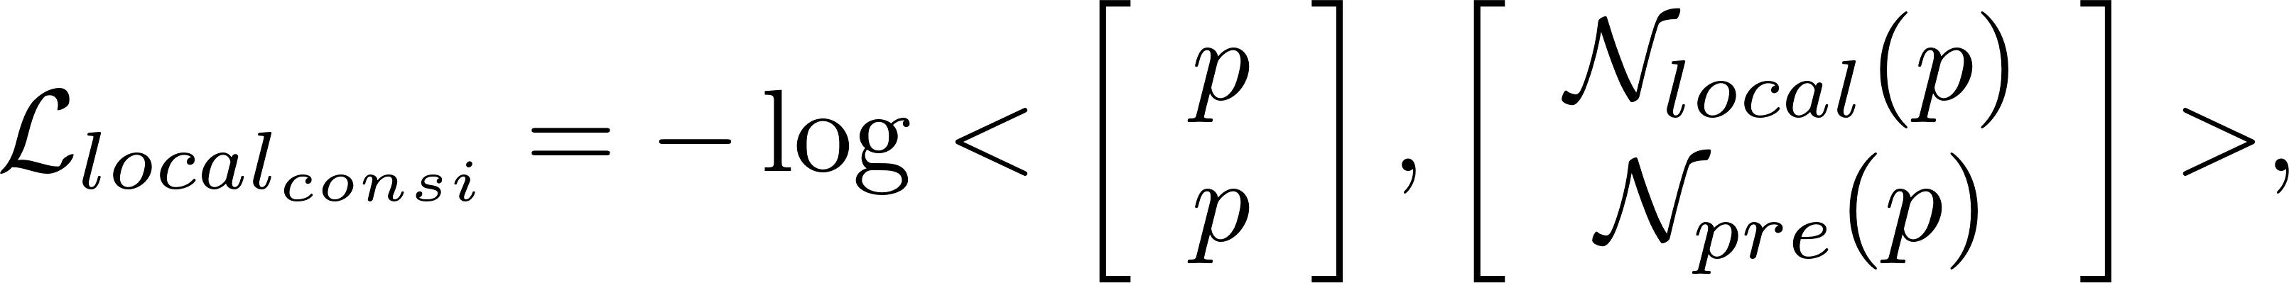
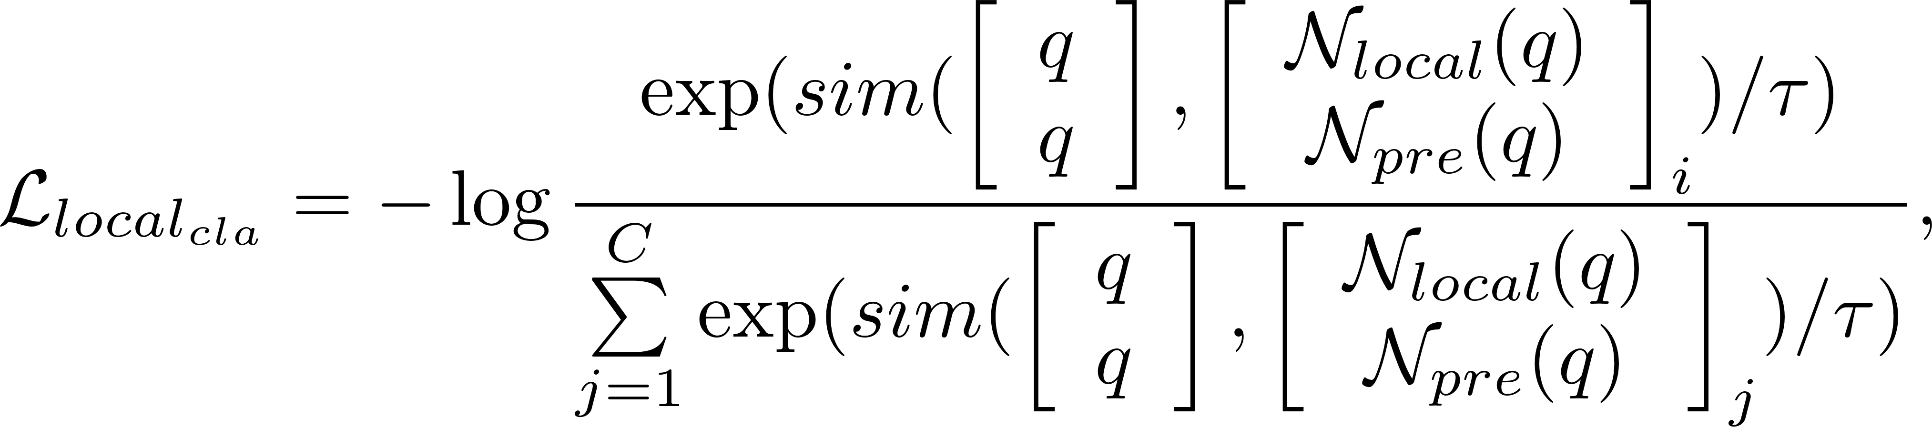
Local Nearest Neighbor Matching
Besides pre-trained based nearest neighbors , we can adopt nearest neighbors from batch features with two losses:

Slide 11
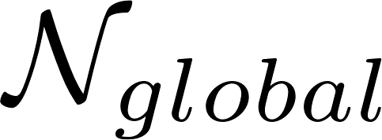
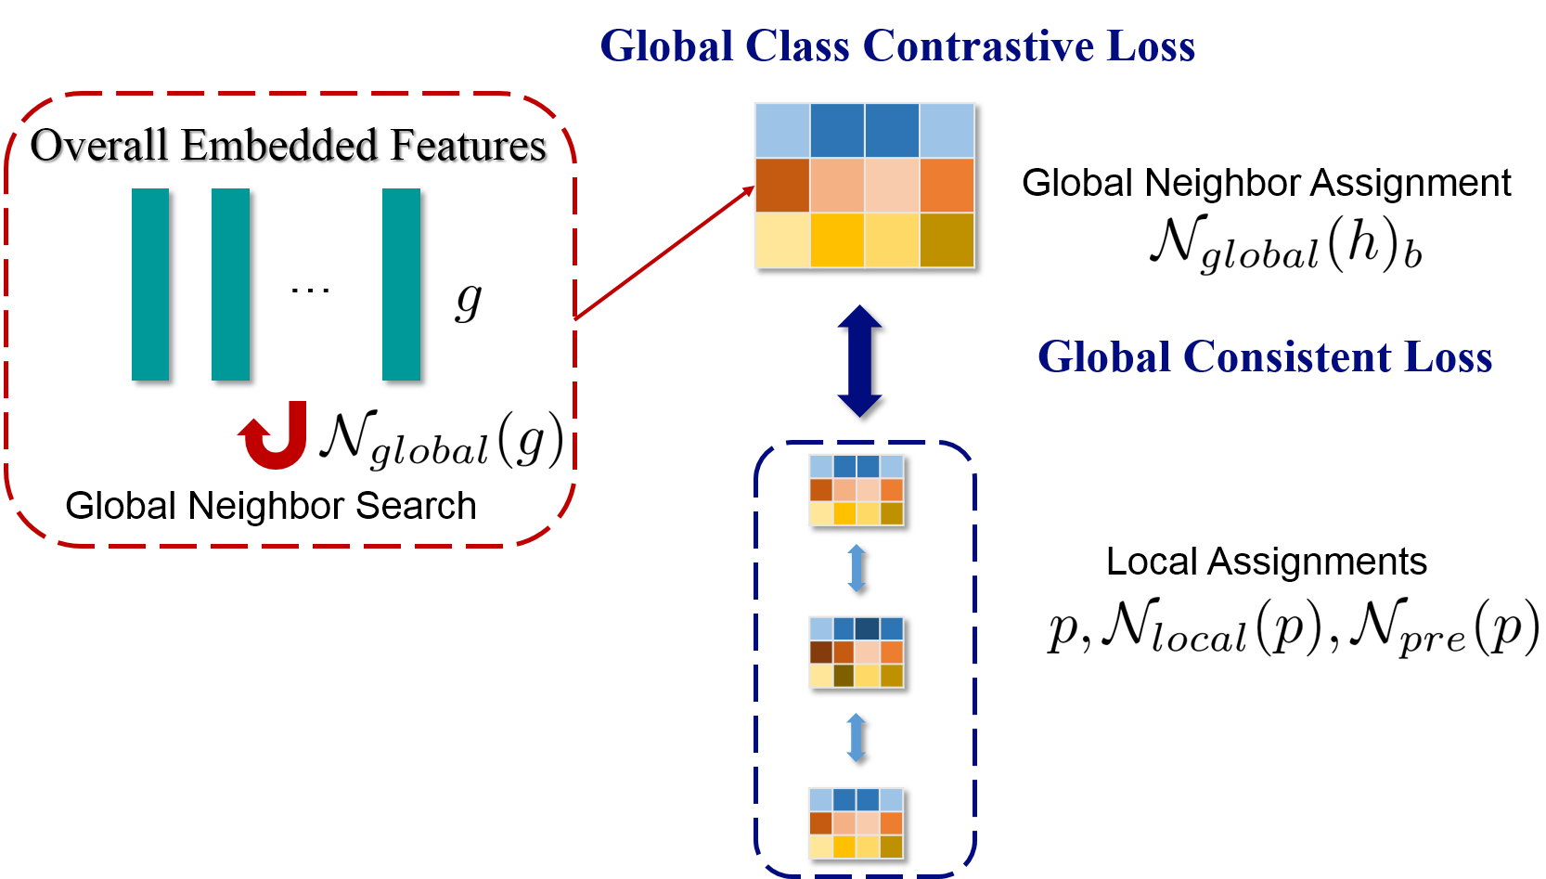
Global Nearest Neighbor Matching
Besides mined nearest neighbors and , we can also adopt nearest neighbors from overall features with two losses:

Slide 12
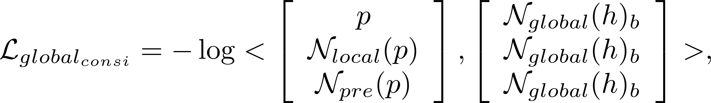
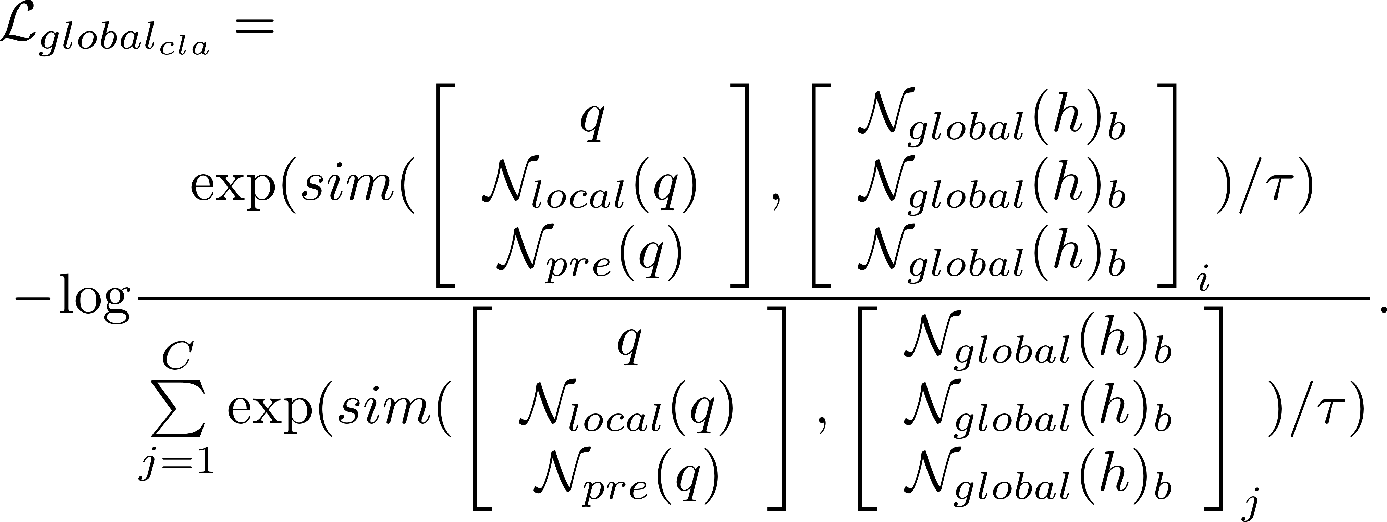
Global Nearest Neighbor Matching
Besides mined nearest neighbors and , we can also adopt nearest neighbors from overall features with two losses:

Slide 13
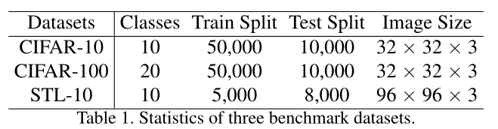
Nearest Neighbor Matching
we have the following total losses:
is the entropy term to prevent the trivial solution that assigns a majority of samples into a minority of clusters.
Datasets:

Slide 14
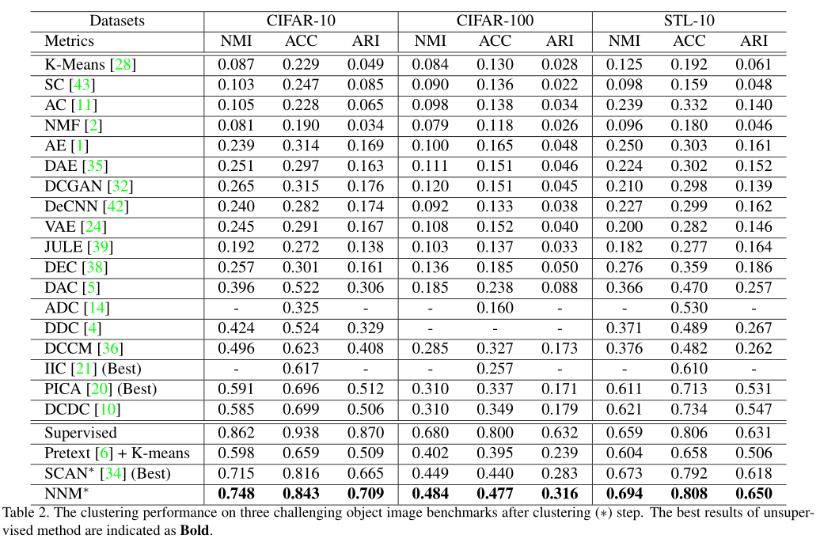
Experiment Results

Slide 15
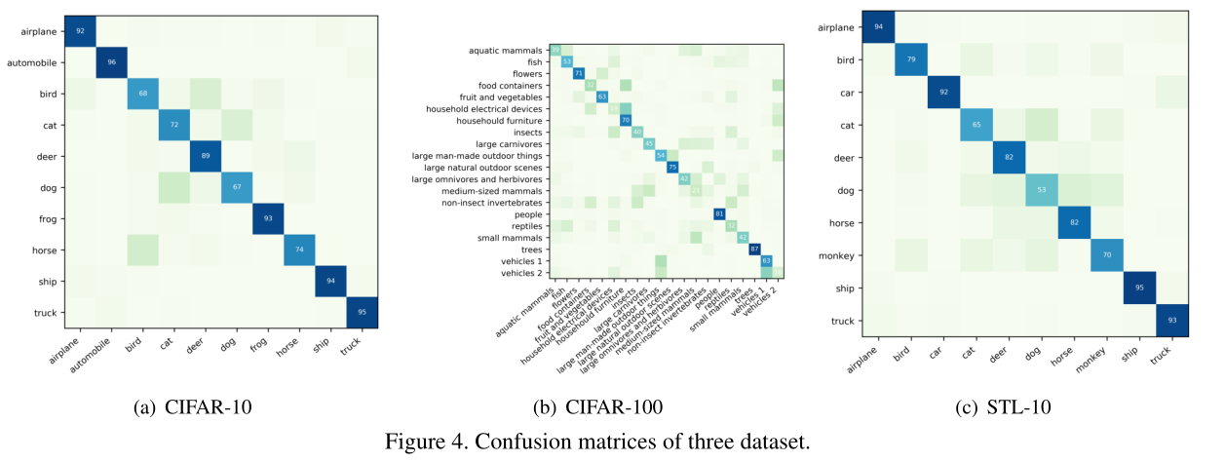
Confusion matrices

Slide 16
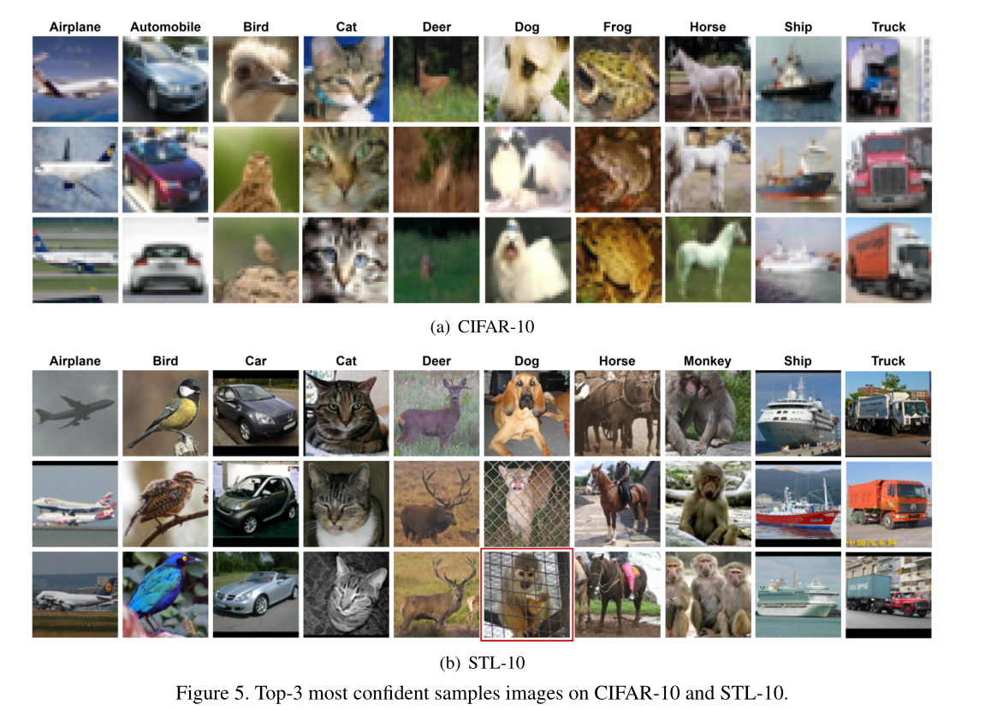
Confident Images

